Slide 1
DEPARTMENT OF CSE
COURSE NAME – ADAPTIVE Software Engineering
COURSE CODE – 22CS2119R
Topic:
Validation testing

Slide 2
AIM OF THE SESSION
To familiarize students with the basic concept of Validation Testing
INSTRUCTIONAL OBJECTIVES
This Session is designed to:
Demonstrate what is validation testing
Describe importance of validation testing in software
List out the phases of validation testing
Describe the types of validation testing
LEARNING OUTCOMES
At the end of this session, you should be able to:
Define validation testing
2. Importance of validation testing in software development

Slide 3
AGENDA
What is validation testing
Why validation testing is important
Steps involved in validation testing
Stages involved in validation testing
Types of validation testing

Slide 4
Validation testing
Validation testing is the process of assessing a new software product to ensure that its performance matches consumer needs and expectations.
Validation tests must be run after every feature or step in the development process is completed.

Slide 5
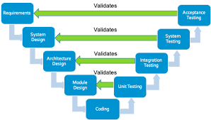
Validation testing

Slide 6
Why Validation testing is important
Software validation can help product development teams ensure their product can satisfy customer needs and expectations.
Validation testing can also help software developers identify and fix coding bugs or address other areas of improvement before launching the product.

Slide 7
Steps in Validation testing
1.You gather the business requirements for validation testing from the end user.
2. Prepare the business plan and send it for approval to the onsite/stakeholders involved.
3. On approval of the plan, you begin to write the necessary test cases and send them for approval.
4. Once approved you begin to complete testing with the required software, and environment and
send the deliverables as requested by the client.
5. Upon approval of the deliverables, UAT testing is done by the client.
6. After that, the software goes into production.

Slide 8
Stages in Validation testing
1.Design Qualification
2.Installation Qualification
3.Operational Qualification
4.Performance Qualification
5.Production

Slide 9
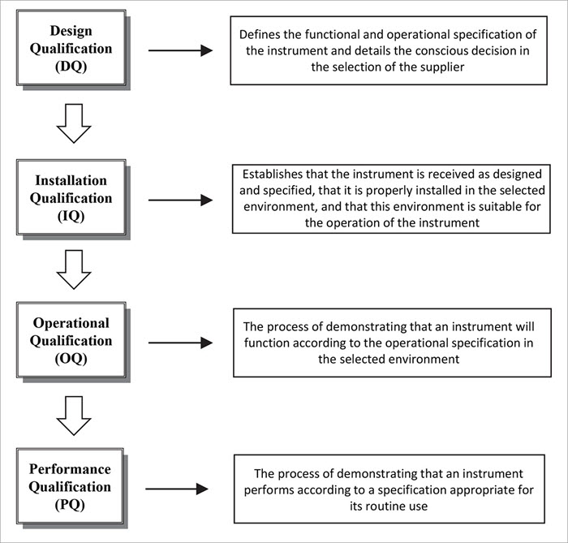
Stages in Validation testing

Slide 10
Design qualification
The process of design qualification, or DQ, includes creating a list of end-user business requirements and designing a validation testing plan to address them before launching the product. This plan can also be a useful written record of the design specifications that the developer and consumer desire. After writing the testing plan, development teams can seek approval from managers or shareholders before they begin the testing process.

Slide 11
Installation qualification
Installation qualification, or IQ, involves installing the software according to the validation testing plan. Product development teams may ensure that both system hardware and the installation process itself match the design specifications. This phase also involves ensuring that the test environment is suitable for product operation and matches the environment in which the product is likely to perform once the company releases it to the public.

Slide 12
Operational qualification
Operational qualification, or OQ, involves testing the product with a variety of testing operations to ensure the product meets the specified user requirements.

Slide 13
Performance qualification
Performance qualification, or PQ, testing verifies that a product can perform according to business needs in the real world. Developers on the internal team can perform alpha testing to assess the functionality of the software under simulated real-world conditions. After performing their own testing, a product development team can offer clients the chance to test the product through a process called beta testing.

Slide 14
production
After completing all levels of validation testing, a software product may go into production. This means that the product is ready to be marketed and sold to consumers. The software development team might help facilitate the deployment and installation process.

Slide 15
Types of validation testing
1.Unit Testing
2.Integration Testing
3.System Testing
4.User Acceptance Testing(UAT)

Slide 16
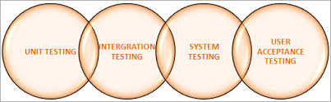
Types of validation testing

Slide 17
Unit testing
Unit testing is a form of validation testing that involves assessing small pieces of code individually. Units can include pieces of code like functions, methods, procedures, modules or objects. Testing these units separately from each other can help ensure that each is performing well. This improves the chance of the software functioning well overall.

Slide 18
integration testing
After performing unit testing to if each unit of code within the software is functioning correctly, software development teams can run integration testing to learn about how well the units function once they integrate them together into a larger system. Specifically, developers can ensure that data flow across modules is successful.
The two main types of integration testing are the top-down approach and the bottom-up approach.

Slide 19
System testing
Also known as system-level testing or system-integration testing, this type of validation testing can assess the software as a complete system. This can help confirm that the product functions according to the end-to-end system specifications

Slide 20
User acceptance testing
User acceptance testing, or UAT, is a form of performance qualification beta testing that invites a client to test the product and ensure that it meets their needs. This is often the last stage in the validation testing process and can be helpful because it tests the product in its proper environment. It can also help reveal challenges that the developers may not have noticed because they're already so familiar with the product.

Slide 21
SELF-ASSESSMENT QUESTIONS
Define Validation testing.
What is the importance of validation testing .
What is integration testing

Slide 22
REFERENCES FOR FURTHER LEARNING OF THE SESSION
TEXTBOOKS:
1. Roger S.Pressman, “Software Engineering – A Practitioner’s Approach” 7th Edition, Mc Graw Hill,(2014).
2. Ian Sommerville, “Software Engineering”, Tenth Edition, Pearson Education, (2015).
3. Agile Software Development Ecosystems, Jim Highsmith, Addison Wesley; ISBN: 0201760436; 1st edition
Reference Book
Agile Modelling: Effective Practices for Extreme Programming and the Unified Process Scott Amber John Wiley & Sons; ISBN: 0471202827; 1st edition.
WEB REFERNCES/MOOCS:
https://www.digite.com/kanban/what-is-kanban/
http://www.scaledagileframework.com
https://www.guru99.com/test-driven-development.html
https://junit.org/junit5/

Slide 23

THANK YOU
Team – ADAPTIVE SOFTWARE ENGINEERING

